Slide 1
Why we test?

Slide 2
To not be afraid of code changes

Slide 3
It facilitates change (refactoring)

Slide 4
Learning unit testing doesn’t stop at mastering the technical bits of it, such as your favorite test framework, mocking library, and so on. There’s much more to unit testing than the act of writing tests. You always have to strive to achieve the best return on the time you invest in unit testing, minimizing the effort you put into tests and maximizing the benefits they provide. Achieving both things isn’t an easy task.
It’s fascinating to watch projects that have achieved this balance: they grow effortlessly, don’t require much maintenance, and can quickly adapt to their customers' ever-changing needs. It’s equally frustrating to see projects that failed to do so. Despite all the effort and an impressive number of unit tests, such projects drag on slowly, with lots of bugs and upkeep costs.
That’s the difference between various unit testing techniques. Some yield great outcomes and help maintain software quality. Others don’t: they result in tests that don’t contribute much, break often, and require a lot of maintenance in general.

Slide 5
Current state of unit testing
For the past two decades, there’s been a push toward adopting unit testing. The push has been so successful that unit testing is now considered mandatory in most companies. Most programmers practice unit testing and understand its importance. There’s no longer any dispute as to whether you should do it. Unless you’re working on a throw-away project, the answer is: you do.

Slide 6
But, as with all new technologies, unit testing continues to evolve. The discussion has shifted from "Should we write unit tests?" to "What does it mean to write good unit tests?" This is where the main confusion still lies.
You can see the results of this confusion in software projects. Many projects have automated tests; they may even have a lot of them. But the existence of those tests often doesn’t provide the results the developers hope for. It can still take programmers a lot of effort to make progress in such projects. New features take forever to implement, new bugs constantly appear in the already implemented and accepted functionality, and the unit tests that are supposed to help don’t seem to mitigate this situation at all. They can even make it worse.

Slide 7
The goal of unit testing
Before taking a deep dive into the topic of unit testing, let’s step back and consider the goal that unit testing helps you to achieve. It’s often said that unit testing practices lead to a better design. And it’s true: the necessity to write unit tests for a code base normally leads to a better design. But that’s not the main goal of unit testing; it’s merely a pleasant side effect.
The ability to unit test a piece of code is a nice litmus test, but it only works in one direction. It’s a good negative indicator — it points out poor-quality code with relatively high accuracy. If you find that code is hard to unit test, it’s a strong sign that the code needs improvement. The poor quality usually manifests itself in tight coupling, which means different pieces of production code are not decoupled from each other enough, and it’s hard to test them separately.
Unfortunately, the ability to unit test a piece of code is a bad positive indicator. The fact that you can easily unit test your code base doesn’t necessarily mean it’s of good quality. The project can be a disaster even when it exhibits a high degree of decoupling.

Slide 8
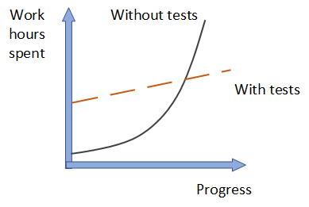
What is the goal of unit testing, then? The goal is to enable sustainable growth of the software project. The term sustainable is key. It’s quite easy to grow a project, especially when you start from scratch. It’s much harder to sustain this growth over time.
Figure 1.1 shows the growth dynamic of a typical project without tests. You start off quickly because there’s nothing dragging you down. No bad architectural decisions have been made yet, and there isn’t any existing code to worry about. As time goes by, however, you have to put in more and more hours to make the same amount of progress you showed at the beginning. Eventually, the development speed slows down significantly, sometimes even to the point when you can’t make any progress whatsoever.

Slide 9
This phenomenon of quickly decreasing development speed is also known as software entropy. Entropy (the amount of disorder in a system) is a mathematical and scientific concept that can also apply to software systems. (If you’re interested in the math and science of entropy, look up the second law of thermodynamics.)
In software, entropy manifests in the form of code that tends to deteriorate. Each time you change something in a code base, the amount of disorder in it, or entropy, increases. If left without proper care, such as constant cleaning and refactoring, the system becomes increasingly complex and disorganized. Fixing one bug introduces more bugs, and modifying one part of the software breaks several others — it’s like a domino effect. Eventually, the code base becomes unreliable. And worst of all, it’s hard to bring it back to stability.

Slide 10
Tests help overturn this tendency. They act as a safety net — a tool that provides insurance against a vast majority of regressions. Tests help make sure the existing functionality works, even after you introduce new features or refactor the code to better fit new requirements.
The downside here is that tests require initial, sometimes significant, effort. But they pay for themselves in the long run by helping the project to grow in the later stages. Software development without the help of tests that constantly verify the code base simply doesn’t scale.
Sustainability and scalability are the keys. They allow you to maintain development speed in the long run.

Slide 11
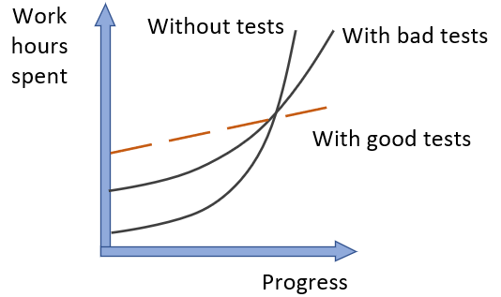
What makes a good or bad test?
As shown in figure 1.2, bad tests do help to slow down code deterioration at the beginning: the decline in development speed is less prominent compared to the situation with no tests at all. But nothing really changes in the grand scheme of things. It might take longer for such a project to enter the stagnation phase, but stagnation is still inevitable.
It’s easy to create tests whose net value is close to zero or even is negative due to high maintenance costs. To enable sustainable project growth, you have to exclusively focus on high-quality tests — those are the only type of tests that are worth keeping in the test suite.

Slide 12
Remember, not all tests are created equal. Some of them are valuable and contribute a lot to overall software quality. Others don’t. They raise false alarms, don’t help you catch regression errors, and are slow and difficult to maintain. It’s easy to fall into the trap of writing unit tests for the sake of unit testing without a clear picture of whether it helps the project.
You can’t achieve the goal of unit testing by just throwing more tests at the project. You need to consider both the test’s value and its upkeep cost. The cost component is determined by the amount of time spent on various activities:
Refactoring the test when you refactor the underlying code
Running the test on each code change
Dealing with false alarms raised by the test
Spending time reading the test when you’re trying to understand how the underlying code behaves
It’s easy to create tests whose net value is close to zero or even is negative due to high maintenance costs. To enable sustainable project growth, you have to exclusively focus on high-quality tests — those are the only type of tests that are worth keeping in the test suite.

Slide 13
PRODUCTION CODE VS. TEST CODE
People often think production code and test code are different. Tests are assumed to be an addition to production code that has no cost of ownership. By extension, people often believe that the more tests, the better.
This isn’t the case. Code is a liability, not an asset. The more code you introduce, the more you extend the surface area for potential bugs in your software, and the higher the project’s upkeep cost. It’s always better to solve problems with as little code as possible.
Tests are code, too. You should view them as the part of your code base that aims at solving a particular problem: ensuring the application’s correctness. Unit tests, just like any other code, are also vulnerable to bugs and require maintenance.

Slide 14
Using coverage metrics to measure test suite quality
There are different types of coverage metrics, and they’re often used to assess the quality of a test suite. The common belief is that the higher the coverage number, the better.
Unfortunately, it’s not that simple, and coverage metrics, while providing valuable feedback, can’t be used to effectively measure the quality of a test suite. It’s the same situation as with the ability to unit test the code: coverage metrics are a good negative indicator but a bad positive one.
If a metric shows that there’s too little coverage in your code base — say, only 10% — that’s a good indication that you are not testing enough. But the reverse isn’t true: even 100% coverage isn’t a guarantee that you have a good-quality test suite. A test suite that provides high coverage can still be of poor quality.

Slide 15
Understanding the code-coverage metric
Code coverage (test coverage) = Lines of code executed / Total number of lines
Notes:
THE CODE COVERAGE (TEST COVERAGE) METRIC IS CALCULATED AS THE RATIO BETWEEN THE NUMBER OF CODE LINES EXECUTED BY THE TEST SUITE AND THE TOTAL NUMBER OF LINES IN THE PRODUCTION CODE BASE.

Slide 16
Tested 3/4 lines = > Line coverage = 75%
Tested 2/2 lines = > Line coverage = 100%
Notes:
It’s easy to calculate the code coverage here. The total number of lines in the method is five (curly braces count, too). The number of lines executed by the test is four — the test goes through all the code lines except for the return true statement. This gives us 4/5 = 0.8 = 80% code coverage.
Does the code-coverage number change? Yes, it does. Because the test now exercises all three lines of code (the return statement plus two curly braces), the code coverage increases to 100%.
But did I improve the test suite with this refactoring? Of course not. I just shuffled the code inside the method. The test still verifies the same number of possible outcomes.
This simple example shows how easy it is to game the coverage numbers. The more compact your code is, the better the test coverage metric becomes, because it only accounts for the raw line numbers. At the same time, squashing more code into less space doesn’t (and shouldn’t) change the value of the test suite or the maintainability of the underlying code base.

Slide 17
Understanding the branch coverage metric
Branch coverage = Branches traversed / Total number of branches
Notes:
THE BRANCH METRIC IS CALCULATED AS THE RATIO OF THE NUMBER OF CODE BRANCHES EXERCISED BY THE TEST SUITE AND THE TOTAL NUMBER OF BRANCHES IN THE PRODUCTION CODE BASE.

Slide 18
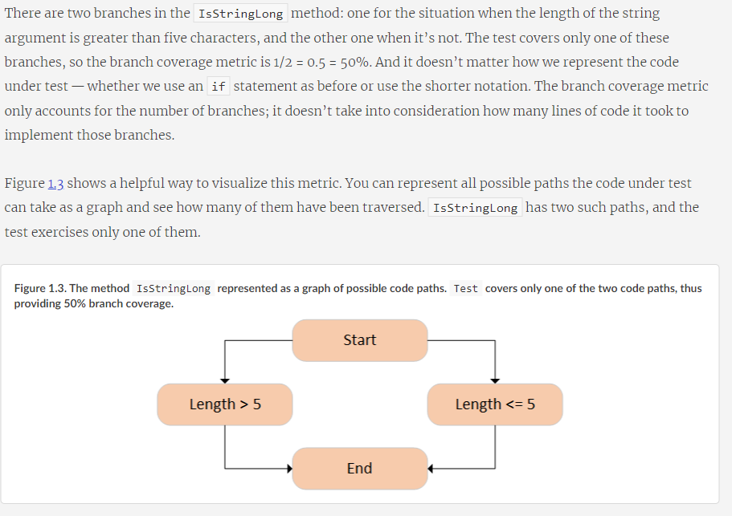

Slide 19
Problems with coverage metrics
Although the branch coverage metric yields better results than code coverage, you still can’t rely on either of them to determine the quality of your test suite, for two reasons:
You can’t guarantee that the test verifies all the possible outcomes of the system under test.
No coverage metric can take into account code paths in external libraries.
Let’s look more closely at each of these reasons.

Slide 20
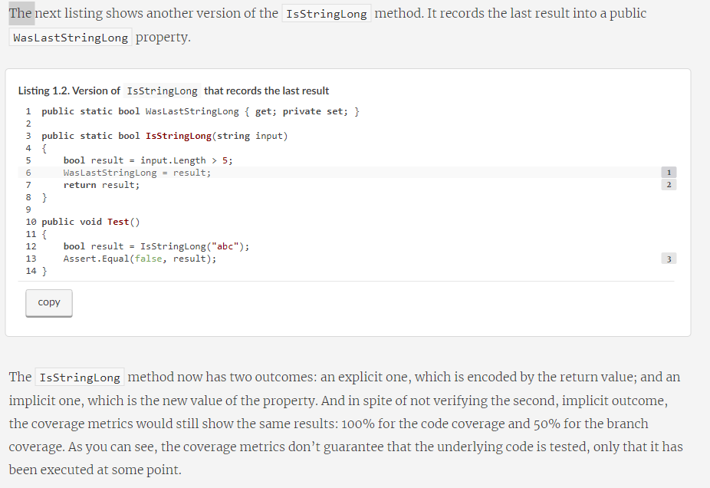
Notes:
For the code paths to be actually tested and not just exercised, your unit tests must have appropriate assertions. In other words, you need to check that the outcome the system under test produces is the exact outcome you expect it to produce. Moreover, this outcome may have several components; and for the coverage metrics to be meaningful, you need to verify all of them.
The IsStringLong method now has two outcomes: an explicit one, which is encoded by the return value; and an implicit one, which is the new value of the property. And in spite of not verifying the second, implicit outcome, the coverage metrics would still show the same results: 100% for the code coverage and 50% for the branch coverage. As you can see, the coverage metrics don’t guarantee that the underlying code is tested, only that it has been executed at some point.

Slide 21
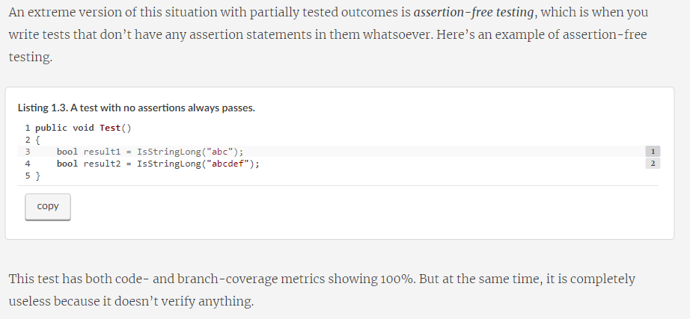

Slide 22
Aiming at a particular coverage number
At this point, I hope you can see that relying on coverage metrics to determine the quality of your test suite is not enough. It can also lead to dangerous territory if you start making a specific coverage number a target, be it 100%, 90%, or even a moderate 70%. The best way to view a coverage metric is as an indicator, not a goal in and of itself.
Think of a patient in a hospital. Their high temperature might indicate a fever and is a helpful observation. But the hospital shouldn’t make the proper temperature of this patient a goal to target by any means necessary. Otherwise, the hospital might end up with the quick and "efficient" solution of installing an air conditioner next to the patient and regulating their temperature by adjusting the amount of cold air flowing onto their skin. Of course, this approach doesn’t make any sense.
Likewise, targeting a specific coverage number creates a perverse incentive that goes against the goal of unit testing. Instead of focusing on testing the things that matter, people start to seek ways to attain this artificial target. Proper unit testing is difficult enough already. Imposing a mandatory coverage number only distracts developers from being mindful about what they test, and makes proper unit testing even harder to achieve.

Slide 23
I’ve spent most of this chapter discussing improper ways to measure the quality of a test suite: using coverage metrics. What about a proper way? How should you measure your test suite’s quality? The only reliable way is to evaluate each test in the suite individually, one by one. Of course, you don’t have to evaluate all of them at once; that could be quite a large undertaking and require significant upfront effort. You can perform this evaluation gradually. The point is that there’s no automated way to see how good your test suite is. You have to apply your personal judgment.

Slide 24
A successful test suite has the following properties
It’s integrated into the development cycle.
It targets only the most important parts of your code base.
It provides maximum value with minimum maintenance costs.
Notes:
It’s integrated into the development cycle
The only point in having automated tests is if you constantly use them. All tests should be integrated into the development cycle. Ideally, you should execute them on every code change, even the smallest one.

Slide 25
It’s integrated into the development cycle
The only point in having automated tests is if you constantly use them. All tests should be integrated into the development cycle. Ideally, you should execute them on every code change, even the smallest one.

Slide 26
It targets only the most important parts of your code base
Just as all tests are not created equal, not all parts of your code base are worth the same attention in terms of unit testing. The value the tests provide is not only in how those tests themselves are structured, but also in the code they verify.
It’s important to direct your unit testing efforts to the most critical parts of the system and verify the others only briefly or indirectly. In most applications, the most important part is the part that contains business logic—the domain model.^{[1]} Testing business logic gives you the best return on your time investment.

Slide 27
All other parts can be divided into three categories:
Infrastructure code
External services and dependencies, such as the database and third-party systems
Code that glues everything together
Notes:
Some of these other parts may still need thorough unit testing, though. For example, the infrastructure code may contain complex and important algorithms, so it would make sense to cover them with a lot of tests, too. But in general, most of your attention should be spent on the domain model.
Some of your tests, such as integration tests, can go beyond the domain model and verify how the system works as a whole, including the noncritical parts of the code base. And that’s fine. But the focus should remain on the domain model.
Note that in order to follow this guideline, you should isolate the domain model from the non-essential parts of the code base. You have to keep the domain model separated from all other application concerns so you can focus your unit testing efforts on that domain model exclusively. We talk about all this in detail in part 2 of the book.

Slide 28
What is a unit test?
These views are known as the classical and the London schools of unit testing. The classical school is called “classical” because it’s how everyone originally approached unit testing and test-driven development. The London school takes root in the programming community in London. The discussion in this chapter about the differences between the classical and London styles lays the foundation for chapter 5, where I cover the topic of mocks and test fragility in detail.
Let’s start by defining a unit test, with all due caveats and subtleties. This definition is the key to the difference between the classical and London schools

Slide 29
The definition of “unit test”
There are a lot of definitions of a unit test. Stripped of their non-essential bits, the definitions all have the following three most important attributes. A unit test is an automated test that
Verifies a small piece of code (also known as a unit),
Does it quickly,
And does it in an isolated manner.
Notes:
The first two attributes here are pretty non-controversial. There might be some dispute as to what exactly constitutes a fast unit test because it’s a highly subjective measure. But overall, it’s not that important. If your test suite’s execution time is good enough for you, it means your tests are quick enough.

Slide 30
THE CLASSICAL AND LONDON SCHOOLS OF UNIT TESTING
The classical approach is also referred to as the Detroit and, sometimes, the classicist approach to unit testing. Probably the most canonical book on the classical school is the one by Kent Beck: Test-Driven Development: By Example (Addison-Wesley Professional, 2002).
The London style is sometimes referred to as mockist. Although the term mockist is widespread, people who adhere to this style of unit testing generally don’t like it, so I call it the London style throughout this book. The most prominent proponents of this approach are Steve Freeman and Nat Pryce. I recommend their book, Growing Object-Oriented Software, Guided by Tests (Addison-Wesley Professional, 2009), as a good source on this subject.

Slide 31
The isolation issue: The London take
What does it mean to verify a piece of code—a unit—in an isolated manner? The London school describes it as isolating the system under test from its collaborators. It means if a class has a dependency on another class, or several classes, you need to replace all such dependencies with test doubles. This way, you can focus on the class under test exclusively by separating its behavior from any external influence.
Notes:
DEFINITION
A test double is an object that looks and behaves like its release-intended counterpart but is actually a simplified version that reduces the complexity and facilitates testing. This term was introduced by Gerard Meszaros in his book, xUnit Test Patterns: Refactoring Test Code (Addison-Wesley, 2007). The name itself comes from the notion of a stunt double in movies.

Slide 32
Notes:
One benefit of this approach is that if the test fails, you know for sure which part of the code base is broken: it’s the system under test. There could be no other suspects, because all of the class’s neighbors are replaced with the test doubles.
Another benefit is the ability to split the object graph—the web of communicating classes solving the same problem. This web may become quite complicated: every class in it may have several immediate dependencies, each of which relies on dependencies of their own, and so on. Classes may even introduce circular dependencies, where the chain of dependency eventually comes back to where it started.
Trying to test such an interconnected code base is hard without test doubles. Pretty much the only choice you are left with is re-creating the full object graph in the test, which might not be a feasible task if the number of classes in it is too high.
With test doubles, you can put a stop to this. You can substitute the immediate dependencies of a class; and, by extension, you don’t have to deal with the dependencies of those dependencies, and so on down the recursion path. You are effectively breaking up the graph—and that can significantly reduce the amount of preparations you have to do in a unit test.

Slide 33
Isolating the class under test from its dependencies helps establish a simple test suite structure: one class with tests for each class in the production code.
Notes:
And let’s not forget another small but pleasant side benefit of this approach to unit test isolation: it allows you to introduce a project-wide guideline of testing only one class at a time, which establishes a simple structure in the whole unit test suite. You no longer have to think much about how to cover your code base with tests. Have a class? Create a corresponding class with unit tests! Figure 2.2 shows how it usually looks.

Slide 34
Shared, private, and out-of-process dependencies
A shared dependency is a dependency that is shared between tests and provides means for those tests to affect each other’s outcome. A typical example of shared dependencies is a static mutable field. A change to such a field is visible across all unit tests running within the same process. A database is another typical example of a shared dependency.
A private dependency is a dependency that is not shared.
An out-of-process dependency is a dependency that runs outside the application’s execution process; it’s a proxy to data that is not yet in the memory. An out-of-process dependency corresponds to a shared dependency in the vast majority of cases, but not always. For example, a database is both out-of-process and shared. But if you launch that database in a Docker container before each test run, that would make this dependency out-of-process but not shared, since tests no longer work with the same instance of it. Similarly, a read-only database is also out-of-process but not shared, even if it’s reused by tests. Tests can’t mutate data in such a database and thus can’t affect each other’s outcome.

Slide 35
Notes:
This take on the isolation issue entails a much more modest view on the use of mocks and other test doubles. You can still use them, but you normally do that for only those dependencies that introduce a shared state between tests. Figure 2.3 shows how it looks.
Isolating unit tests from each other entails isolating the class under test from shared dependencies only. Private dependencies can be kept intact.

Slide 36
Shared vs. volatile dependencies
A volatile dependency is a dependency that exhibits one of the following properties:
It introduces a requirement to set up and configure a runtime environment in addition to what is installed on a developer’s machine by default. Databases and API services are good examples here. They require additional setup and are not installed on machines in your organization by default.
It contains nondeterministic behavior. An example would be a random number generator or a class returning the current date and time. These dependencies are non-deterministic because they provide different results on each invocation.
Notes:
As you can see, there’s an overlap between the notions of shared and volatile dependencies. For example, a dependency on the database is both shared and volatile. But that’s not the case for the file system. The file system is not volatile because it is installed on every developer’s machine and it behaves deterministically in the vast majority of cases. Still, the file system introduces a means by which the unit tests can interfere with each other’s execution context; hence it is shared. Likewise, a random number generator is volatile, but because you can supply a separate instance of it to each test, it isn’t shared.
Another reason for substituting shared dependencies is to increase the test execution speed. Shared dependencies almost always reside outside the execution process, while private dependencies usually don’t cross that boundary. Because of that, calls to shared dependencies, such as a database or the file system, take more time than calls to private dependencies. And since the necessity to run quickly is the second attribute of the unit test definition, such calls push the tests with shared dependencies out of the realm of unit testing and into the area of integration testing. I talk more about integration testing later in this chapter.

Slide 37
The classical and London schools of unit testing
As you can see, the root of the differences between the London and classical schools is the isolation attribute. The London school views it as isolation of the system under test from its collaborators, whereas the classical school views it as isolation of unit tests themselves from each other.
This seemingly minor difference has led to a vast disagreement about how to approach unit testing, which, as you already know, produced the two schools of thought. Overall, the disagreement between the schools spans three major topics:

Slide 38
The isolation requirement
What constitutes a piece of code under test (a unit)
Handling dependencies

Slide 39
Figure 2.4. The hierarchy of dependencies. The classical school advocates for replacing shared dependencies with test doubles. The London school advocates for the replacement of private dependencies as well, as long as they are mutable.

Slide 40
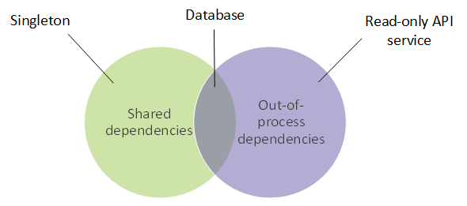
Notes:
The relation between shared and out-of-process dependencies. An example of a dependency that is shared but not out-of-process is a singleton (an instance that is reused by all tests) or a static field in a class. A database is shared and out-of-process — it resides outside the main process and is mutable. A read-only API is out-of-process but not shared, since tests can’t modify it and thus can’t affect each other’s execution flow.

Slide 41
To reiterate, the main difference between the classical and London schools is in how they treat the isolation issue in the definition of a unit test. This, in turn, spills over to the treatment of a unit — the thing that should be put under test — and the approach to handling dependencies.
As I mentioned previously, I prefer the classical school of unit testing. It tends to produce tests of higher quality and thus is better suited for achieving the ultimate goal of unit testing, which is the sustainable growth of your project. The reason is fragility: tests that use mocks tend to be more brittle than classical tests (more on this in chapter 5). For now, let’s take the main selling points of the London school and evaluate them one by one.

Slide 42
The London school’s approach provides the following benefits:
Better granularity. The tests are fine grained and check only one class at a time.
It’s easier to unit test a larger graph of interconnected classes. Since all collaborators are replaced by test doubles, you don’t need to worry about them at the time of writing the test.
If a test fails, you know for sure which functionality has failed. Without the class’s collaborators, there could be no suspects other than the class under test itself. Of course, there may still be situations where the system under test uses a value object and it’s the change in this value object that makes the test fail. But these cases aren’t that frequent because all other dependencies are eliminated in tests.

Slide 43
TEST-DRIVEN DEVELOPMENT
Test-driven development is a software development process that relies on tests to drive the project development. The process consists of three (some authors specify four) stages, which you repeat for every test case:
Write a failing test to indicate which functionality needs to be added and how it should behave.
Write just enough code to make the test pass. At this stage, the code doesn’t have to be elegant or clean.
Refactor the code. Under the protection of the passing test, you can safely clean up the code to make it more readable and maintainable.
Notes:
Good sources on this topic are the two books I recommended earlier: Kent Beck’s Test-Driven Development: By Example and Growing Object-Oriented Software, Guided by Tests by Steve Freeman and Nat Pryce.

Slide 44
refined the definition of a unit test
A unit test verifies a single unit of behavior,
Does it quickly,
And in isolation from other tests.

Slide 45
The isolation issue is disputed the most. The dispute led to the formation of two schools of unit testing: the classical (Detroit) school, and the London (mockist) school. This difference of opinion affects the view of what constitutes a unit and the treatment of the system under test’s (SUT’s) dependencies.
The London school states that the units under test should be isolated from each other. A unit under test is a unit of code, usually a class. All of its dependencies, except immutable dependencies, should be replaced with test doubles in tests.
The classical school states that the unit tests need to be isolated from each other, not units. Also, a unit under test is a unit of behavior, not a unit of code. Thus, only shared dependencies should be replaced with test doubles. Shared dependencies are dependencies that provide means for tests to affect each other’s execution flow.
Notes:
For a canonical book about the classical style, I recommend Kent Beck’s Test-Driven Development: By Example. For more on the London style, see Growing Object-Oriented Software, Guided by Tests, by Steve Freeman and Nat Pryce. For further reading about working with dependencies, I recommend Dependency Injection: Principles, Practices, Patterns by Steven van Deursen and Mark Seemann.

Slide 46
Integration tests

Slide 47
End-to-end tests are a subset of integration tests
In short, an integration test is a test that verifies that your code works in integration with shared dependencies, out-of-process dependencies, or code developed by other teams in the organization. There’s also a separate notion of an end-to-end test. End-to-end tests are a subset of integration tests. They, too, check to see how your code works with out-of-process dependencies. The difference between an end-to-end test and an integration test is that end-to-end tests usually include more of such dependencies.
The line is blurred at times, but in general, an integration test works with only one or two out-of-process dependencies. On the other hand, an end-to-end test works with all out-of-process dependencies, or with the vast majority of them. Hence the name end-to-end, which means the test verifies the system from the end user’s point of view, including all the external applications this system integrates with (see figure 2.6).

Slide 48
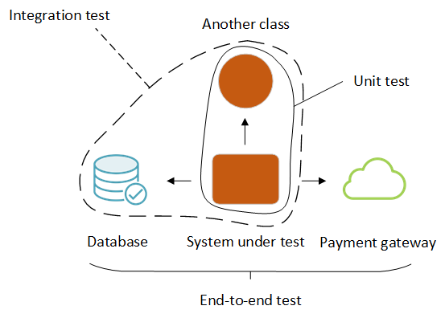
End-to-end tests normally include all or almost all out-of-process dependencies in the scope. Integration tests check only one or two such dependencies — those that are easier to set up automatically, such as the database or the file system.
Notes:
Let’s say your application works with three out-of-process dependencies: a database, the file system, and a payment gateway. A typical integration test would include only the database and file system in scope and use a test double to replace the payment gateway. That’s because you have full control over the database and file system, and thus can easily bring them to the required state in tests, whereas you don’t have the same degree of control over the payment gateway. With the payment gateway, you may need to contact the payment processor organization to set up a special test account. You might also need to check that account from time to time to manually clean up all the payment charges left over from the past test executions.
Since end-to-end tests are the most expensive in terms of maintenance, it’s better to run them late in the build process, after all the unit and integration tests have passed. You may possibly even run them only on the build server, not on individual developers' machines.
Keep in mind that even with end-to-end tests, you might not be able to tackle all of the out-of-process dependencies. There may be no test version of some dependencies, or it may be impossible to bring those dependencies to the required state automatically.
So you may still need to use a test double, reinforcing the fact that there isn’t a distinct line between integration and end-to-end tests.

Slide 49
The anatomy of a unit test

Slide 50
How to structure a unit test
Using the AAA pattern
The AAA pattern advocates for splitting each test into three parts: arrange, act, and assert. (This pattern is sometimes also called the 3A pattern.) Let’s take a Calculator class with a single method that calculates a sum of two numbers:

Slide 51
public class Calculator
{
public double Sum(double first, double second)
{
return first + second;
}
}
public class CalculatorTests
{
[Fact]
public void Sum_of_two_numbers()
{
// Arrange
double first = 10;
double second = 20;
var calculator = new Calculator();
// Act
double result = calculator.Sum(first, second);
// Assert
Assert.Equal(30, result);
}
}
Notes:
The AAA pattern provides a simple, uniform structure for all tests in the suite. This uniformity is one of the biggest advantages of this pattern: once you get used to it, you can easily read and understand any test. That, in turn, reduces maintenance costs for your entire test suite. The structure is as follows:
In the arrange section, you bring the system under test (SUT) and its dependencies to a desired state.
In the act section, you call methods on the SUT, pass the prepared dependencies, and capture the output value (if any).
In the assert section, you verify the outcome. The outcome may be represented by the return value, the final state of the SUT and its collaborators, or the methods the SUT called on those collaborators.

Slide 52
GIVEN-WHEN-THEN PATTERN
You might have heard of the Given-When-Then pattern, which is similar to AAA. This pattern also advocates for breaking the test down into three parts:
Given — Corresponds to the arrange section
When — Corresponds to the act section
Then — Corresponds to the assert section
Notes:
There’s no difference between the two patterns in terms of the test composition. The only distinction is that the Given-When-Then structure is more readable to non-programmers. Thus, Given-When-Then is more suitable for tests that are shared with non-technical people.

Slide 53
The natural inclination is to start writing a test with the arrange section. After all, it comes before the other two. This approach works well in the vast majority of cases, but starting with the assert section is a viable option too. When you practice Test-Driven Development (TDD) — that is, when you create a failing test before developing a feature — you don’t know enough about the feature’s behavior yet. So, it becomes advantageous to first outline what you expect from the behavior and then figure out how to develop the system to meet this expectation.
Such a technique may look counterintuitive, but it’s how we approach problem solving. We start by thinking about the objective: what a particular behavior should to do for us. The actual solving of the problem comes after that. Writing down the assertions before everything else is merely a formalization of this thinking process. But again, this guideline is only applicable when you follow TDD — when you write a test before the production code. If you write the production code before the test, by the time you move on to the test, you already know what to expect from the behavior, so starting with the arrange section is a better option.

Slide 54
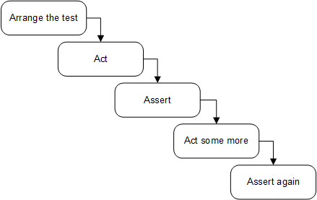
Avoid multiple arrange, act, and assert sections
Notes:
When you see multiple act sections separated by assert and, possibly, arrange sections, it means the test verifies multiple units of behavior. And, as we discussed in chapter 2, such a test is no longer a unit test but rather is an integration test. It’s best to avoid such a test structure. A single action ensures that your tests remain within the realm of unit testing, which means they are simple, fast, and easy to understand. If you see a test containing a sequence of actions and assertions, refactor it. Extract each act into a test of its own.
It’s sometimes fine to have multiple act sections in integration tests. As you may remember from the previous chapter, integration tests can be slow. One way to speed them up is to group several integration tests together into a single test with multiple acts and assertions. It’s especially helpful when system states naturally flow from one another: that is, when an act simultaneously serves as an arrange for the subsequent act.
But again, this optimization technique is only applicable to integration tests — and not all of them, but rather those that are already slow and that you don’t want to become even slower. There’s no need for such an optimization in unit tests or integration tests that are fast enough. It’s always better to split a multistep unit test into several tests.

Slide 55
Avoid if statements in tests
Notes:
Similar to multiple occurrences of the arrange, act, and assert sections, you may sometimes encounter a unit test with an if statement. This is also an anti-pattern. A test — whether a unit test or an integration test — should be a simple sequence of steps with no branching.
An if statement indicates that the test verifies too many things at once. Such a test, therefore, should be split into several tests. But unlike the situation with multiple AAA sections, there’s no exception for integration tests. There are no benefits in branching within a test. You only gain additional maintenance costs: if statements make the tests harder to read and understand.

Slide 56
How large should each section be?

Slide 57
The arrange section is the largest
The arrange section is usually the largest of the three. It can be as large as the act and assert sections combined. But if it becomes significantly larger than that, it’s better to extract the arrangements either into private methods within the same test class or to a separate factory class. Two popular patterns can help you reuse the code in the arrange sections: Object Mother and Test Data Builder.

Slide 58
Watch out for act sections that are larger than a single line
The act section is normally just a single line of code. If the act consists of two or more lines, it could indicate a problem with the SUT’s public API.

Slide 59
[Fact]
public void Purchase_succeeds_when_enough_inventory()
{
// Arrange
var store = new Store();
store.AddInventory(Product.Shampoo, 10);
var customer = new Customer();
// Act
bool success = customer.Purchase(store, Product.Shampoo, 5);
store.RemoveInventory(success, Product.Shampoo, 5);
// Assert
Assert.True(success);
Assert.Equal(5, store.GetInventory(Product.Shampoo));
}
[Fact]
public void Purchase_succeeds_when_enough_inventory()
{
// Arrange
var store = new Store();
store.AddInventory(Product.Shampoo, 10);
var customer = new Customer();
// Act
bool success = customer.Purchase(store, Product.Shampoo, 5);
// Assert
Assert.True(success);
Assert.Equal(5, store.GetInventory(Product.Shampoo));
}
Notes:
The issue with the new version is that it requires two method calls to perform a single operation. Note that this is not an issue with the test itself. The test still verifies the same unit of behavior: the process of making a purchase. The issue lies in the API surface of the Customer class. It shouldn’t require the client to make an additional method call.
From a business perspective, a successful purchase has two outcomes: the acquisition of a product by the customer and the reduction of the inventory in the store. Both of these outcomes must be achieved together, which means there should be a single public method that does both things. Otherwise, there’s a room for inconsistency if the client code calls the first method but not the second, in which case the customer will acquire the product but its available amount won’t be reduced in the store.
Such an inconsistency is called an invariant violation. The act of protecting your code against potential inconsistencies is called encapsulation. When an inconsistency penetrates into the database, it becomes a big problem: now it’s impossible to reset the state of your application by simply restarting it. You’ll have to deal with the corrupted data in the database and, potentially, contact customers and handle the situation on a case-by-case basis. Just imagine what would happen if the application generated confirmation receipts without actually reserving the inventory. It might issue claims to, and even charge for, more inventory than you could feasibly acquire in the near future.

Slide 60
How many assertions should the assert section hold?
Notes:
Finally, there’s the assert section. You may have heard about the guideline of having one assertion per test. It takes root in the premise discussed in the previous chapter: the premise of targeting the smallest piece of code possible.
As you already know, this premise is incorrect. A unit in unit testing is a unit of behavior, not a unit of code. A single unit of behavior can exhibit multiple outcomes, and it’s fine to evaluate them all in one test.
Having that said, you need to watch out for assertion sections that grow too large: it could be a sign of a missing abstraction in the production code. For example, instead of asserting all properties inside an object returned by the SUT, it may be better to define proper equality members in the object’s class. You can then compare the object to an expected value using a single assertion.

Slide 61
Reusing test fixtures between tests
It’s important to know how and when to reuse code between tests. Reusing code between arrange sections is a good way to shorten and simplify your tests, and this section shows how to do that properly.
A test fixture is an object the test runs against. This object can be a regular dependency — an argument that is passed to the SUT. It can also be data in the database or a file on the hard disk. Such an object needs to remain in a known, fixed state before each test run, so it produces the same result. Hence the word fixture.

Slide 62
The first — incorrect — way to reuse test fixtures is to initialize them in the test’s constructor (or the method marked with a [SetUp] attribute if you are using NUnit), as shown next.
public class CustomerTests
{
private readonly Store _store;
private readonly Customer _sut;
public CustomerTests()
{
_store = new Store();
_store.AddInventory(Product.Shampoo, 10);
_sut = new Customer();
}
[Fact]
public void Purchase_succeeds_when_enough_inventory()
{
bool success = _sut.Purchase(_store, Product.Shampoo, 5);
Assert.True(success);
Assert.Equal(5, _store.GetInventory(Product.Shampoo));
}
[Fact]
public void Purchase_fails_when_not_enough_inventory()
{
bool success = _sut.Purchase(_store, Product.Shampoo, 15);
Assert.False(success);
Assert.Equal(10, _store.GetInventory(Product.Shampoo));
}
}
Notes:
The two tests in listing 3.7 have common configuration logic. In fact, their arrange sections are the same and thus can be fully extracted into CustomerTests's constructor — which is precisely what I did here. The tests themselves no longer contain arrangements.
With this approach, you can significantly reduce the amount of test code — you can get rid of most or even all test fixture configurations in tests. But this technique has two significant drawbacks:
It introduces high coupling between tests.
It diminishes test readability.

Slide 63
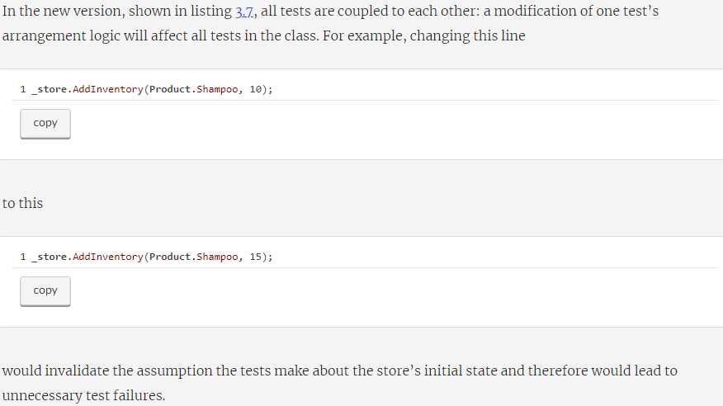
High coupling between tests is an anti-pattern
Notes:
That’s a violation of an important guideline: a modification of one test should not affect other tests. This guideline is similar to what we discussed in chapter 2 — that tests should run in isolation from each other. It’s not the same, though. Here, we are talking about independent modification of tests, not independent execution. Both are important attributes of a well-designed test.

Slide 64
The use of constructors in tests diminishes test readability
The other drawback to extracting the arrangement code into the constructor is diminished test readability. You no longer see the full picture just by looking at the test itself. You have to examine different places in the class to understand what the test method does.
Even if there’s not much arrangement logic — say, only instantiation of the fixtures — you are still better off moving it directly to the test method. Otherwise, you’ll wonder if it’s really just instantiation or something else is being configured there, too. A self-contained test doesn’t leave you with such uncertainties.

Slide 65
A better way to reuse test fixtures
The use of the constructor is not the best approach when it comes to reusing test fixtures. The second way — the beneficial one — is to introduce private factory methods in the test class, as shown in the following listing. public class CustomerTests
{
[Fact]
public void Purchase_succeeds_when_enough_inventory()
{
Store store = CreateStoreWithInventory(Product.Shampoo, 10);
Customer sut = CreateCustomer();
bool success = sut.Purchase(store, Product.Shampoo, 5);
Assert.True(success);
Assert.Equal(5, store.GetInventory(Product.Shampoo));
}
[Fact]
public void Purchase_fails_when_not_enough_inventory()
{
Store store = CreateStoreWithInventory(Product.Shampoo, 10);
Customer sut = CreateCustomer();
bool success = sut.Purchase(store, Product.Shampoo, 15);
Assert.False(success);
Assert.Equal(10, store.GetInventory(Product.Shampoo));
}
private Store CreateStoreWithInventory(
Product product, int quantity)
{
Store store = new Store();
store.AddInventory(product, quantity);
return store;
}
private static Customer CreateCustomer()
{
return new Customer();
}
}
Notes:
By extracting the common initialization code into private factory methods, you can also shorten the test code, but at the same time keep the full context of what’s going on in the tests. Moreover, the private methods don’t couple tests to each other as long as you make them generic enough. That is, allow the tests specify how they want the fixtures be created.

Slide 66
Look at this line, for example:
Store store = CreateStoreWithInventory(Product.Shampoo, 10);
Notes:
The test explicitly states that it wants the factory method to add 10 units of shampoo to the store. This is both highly readable and reusable. It’s readable because you don’t need to examine the internals of the factory method to understand the attributes of the created store. It’s reusable because you can utilize this method in other tests, too.
Note that in this particular example, there’s no need to introduce factory methods, as the arrangement logic is quite simple. View it merely as a demonstration.

Slide 67
There’s one exception to this rule of reusing test fixtures. You can instantiate a fixture in the constructor if it’s used by all or almost all tests. This is often the case for integration tests that work with a database. All such tests require a database connection, which you can initialize once and then reuse everywhere. But even then, it would make more sense to introduce a base class and initialize the database connection in that class’s constructor, not in individual test classes. public class CustomerTests : IntegrationTests
{
[Fact]
public void Purchase_succeeds_when_enough_inventory()
{
/* use _database here */
}
}
public abstract class IntegrationTests : IDisposable
{
protected readonly Database _database;
protected IntegrationTests()
{
_database = new Database();
}
public void Dispose()
{
_database.Dispose();
}
}
Notes:
Notice how CustomerTests remains constructor-less. It gets access to the _database instance by inheriting from the IntegrationTests base class.

Slide 68
Naming a unit test
[MethodUnderTest]_[Scenario]_[ExpectedResult]
MethodUnderTest is the name of the method you are testing.
Scenario is the condition under which you test the method.
ExpectedResult is what you expect the method under test to do in the current scenario.
Notes:
It’s important to give expressive names to your tests. Proper naming helps you understand what the test verifies and how the underlying system behaves.
So, how should you name a unit test? I’ve seen and tried a lot of naming conventions over the past decade. One of the most prominent, and probably least helpful, is the following convention:
[MethodUnderTest]_[Scenario]_[ExpectedResult]
where
MethodUnderTest is the name of the method you are testing.
Scenario is the condition under which you test the method.
ExpectedResult is what you expect the method under test to do in the current scenario.

Slide 69
Unit test naming guidelines
Don’t follow a rigid naming policy. You simply can’t fit a high-level description of a complex behavior into the narrow box of such a policy. Allow freedom of expression.
Name the test as if you were describing the scenario to a non-programmer who is familiar with the problem domain. A domain expert or a business analyst is a good example.
Separate words with underscores. Doing so helps improve readability, especially in long names.

Slide 70
Example: Renaming a test toward the guidelines
[Fact]
public void IsDeliveryValid_InvalidDate_ReturnsFalse()
{
DeliveryService sut = new DeliveryService();
DateTime pastDate = DateTime.Now.AddDays(-1);
Delivery delivery = new Delivery
{
Date = pastDate
};
bool isValid = sut.IsDeliveryValid(delivery);
Assert.False(isValid);
}
Notes:
Let’s take a test as an example and try to gradually improve its name using the guidelines I just outlined. In the following listing, you can see a test verifying that a delivery with a past date is invalid. The test’s name is written using the rigid naming policy that doesn’t help with the test readability.

Slide 71
public void Delivery_with_invalid_date_should_be_considered_invalid()
Notice two things in the new version:
The name now makes sense to a non-programmer, which means programmers will have an easier time understanding it, too.
The name of the SUT’s method — IsDeliveryValid — is no longer part of the test’s name.
Notes:
This test checks that DeliveryService properly identifies a delivery with an incorrect date as invalid. How would you rewrite the test’s name in plain English? The following would be a good first try:
The second point is a natural consequence of rewriting the test’s name in plain English and thus can be easily overlooked. However, this consequence is important and can be elevated into a guideline of its own.

Slide 72
WARNING
Don’t include the name of the SUT’s method in the test’s name.
Notes:
Remember, you don’t test code, you test application behavior. Therefore, it doesn’t matter what the name of the method under test is. As I mentioned previously, the SUT is just an entry point: a means to invoke a behavior. You can decide to rename the method under test to, say, IsDeliveryCorrect, and it will have no effect on the SUT’s behavior. On the other hand, if you follow the original naming convention, you’ll have to rename the test. This once again shows that targeting code instead of behavior couples tests to that code’s implementation details, which negatively affects the test suite’s maintainability. More on this issue in chapter 5.
The only exception to this guideline is when you work on utility code. Such code doesn’t contain business logic — its behavior doesn’t go much beyond simple auxiliary functionality and thus doesn’t mean anything to business people. It’s fine to use the SUT’s method names there.

Slide 73
public void Delivery_with_invalid_date_should_be_considered_invalid()
=>
public void Delivery_with_past_date_should_be_considered_invalid()
=>
public void Delivery_with_past_date_should_be_invalid()
=>
public void Delivery_with_past_date_is_invalid()
=>
public void Delivery_with_a_past_date_is_invalid()
Notes:
But let’s get back to the example. The new version of the test’s name is a good start, but it can be improved further. What does it mean for a delivery date to be invalid, exactly? From the test in listing 3.10, we can see that an invalid date is any date in the past. This makes sense — you should only be allowed to choose a delivery date in the future.
This is better but still not ideal. It’s too verbose. We can get rid of the word considered without any loss of meaning
The wording should be is another common anti-pattern. Earlier in this chapter I mentioned that a test is a single, atomic fact about a unit of behavior. There’s no place for a wish or a desire when stating a fact. Name the test accordingly — replace should be with is:
And finally, there’s no need to avoid basic English grammar. Articles help the test read flawlessly. Add the article a to the test’s name:

Slide 74
Refactoring to parameterized tests
A typical application exhibits multiple behaviors. The greater the complexity of the behavior, the more facts are required to fully describe it. Each fact is represented by a test. Similar facts can be grouped into a single test method using parameterized tests.
Notes:
One test usually is not enough to fully describe a unit of behavior. Such a unit normally consists of multiple components, each of which should be captured with its own test. If the behavior is complex enough, the number of tests describing it can grow dramatically and may become unmanageable. Luckily, most unit testing frameworks provide functionality that allows you to group similar tests using parameterized tests (see figure 3.2). In this section, I’ll first show each such behavior component described by a separate test and then demonstrate how these tests can be grouped together.

Slide 75
public void Delivery_for_today_is_invalid()
public void Delivery_for_tomorrow_is_invalid()
public void The_soonest_delivery_date_is_two_days_from_now()
public class DeliveryServiceTests
{
[InlineData(-1, false)]
[InlineData(0, false)]
[InlineData(1, false)]
[InlineData(2, true)]
[Theory]
public void Can_detect_an_invalid_delivery_date(
int daysFromNow,
bool expected)
{
DeliveryService sut = new DeliveryService();
DateTime deliveryDate = DateTime.Now
.AddDays(daysFromNow);
Delivery delivery = new Delivery
{
Date = deliveryDate
};
bool isValid = sut.IsDeliveryValid(delivery);
Assert.Equal(expected, isValid);
}
}
Notes:
Each fact is now represented by an [InlineData] line rather than a separate test. I also renamed the test method something more generic: it no longer mentions what constitutes a valid or invalid date.

Slide 76
Using parameterized tests, you can significantly reduce the amount of test code, but this benefit comes at a cost. It’s now hard to figure out what facts the test method represents. And the more parameters there are, the harder it becomes. As a compromise, you can extract the positive test case into its own test and benefit from the descriptive naming where it matters the most—in determining what differentiates valid and invalid delivery dates, as shown in the following listing.

Slide 77
public class DeliveryServiceTests
{
[InlineData(-1)]
[InlineData(0)]
[InlineData(1)]
[Theory]
public void Detects_an_invalid_delivery_date(int daysFromNow)
{
/* ... */
}
[Fact]
public void The_soonest_delivery_date_is_two_days_from_now()
{
/* ... */
}
}

Slide 78
https://www.baeldung.com/parameterized-tests-junit-5

Slide 79
Using an assertion library to further improve test readability

Slide 80
Diving into the four pillars of a good unit test
Protection against regressions
Resistance to refactoring
Fast feedback
Maintainability
Notes:
These four attributes are foundational. You can use them to analyze any automated test, be it unit, integration, or end-to-end. Every such test exhibits some degree of each attribute. In this section, I define the first two attributes; and in section 4.2, I describe the intrinsic connection between them.

Slide 81
The first pillar: Protection against regressions
To evaluate how well a test scores on the metric of protecting against regressions, you need to take into account the following:
The amount of code that is executed during the test
The complexity of that code
The code’s domain significance
Notes:
regression is a software bug. It’s when a feature stops working as intended after some code modification, usually after you roll out new functionality.
Generally, the larger the amount of code that gets executed, the higher the chance that the test will reveal a regression. Of course, assuming that this test has a relevant set of assertions, you don’t want to merely execute the code. While it helps to know that this code runs without throwing exceptions, you also need to validate the outcome it produces.
Note that it’s not only the amount of code that matters, but also its complexity and domain significance. Code that represents complex business logic is more important than boilerplate code—bugs in business-critical functionality are the most damaging.
On the other hand, it’s rarely worthwhile to test trivial code. Such code is short and doesn’t contain a substantial amount of business logic. Tests that cover trivial code don’t have much of a chance of finding a regression error, because there’s not a lot of room for a mistake. An example of trivial code is a single-line property like this:
Furthermore, in addition to your code, the code you didn’t write also counts: for example, libraries, frameworks, and any external systems used in the project. That code influences the working of your software almost as much as your own code. For the best protection, the test must include those libraries, frameworks, and external systems in the testing scope, in order to check that the assumptions your software makes about these dependencies are correct.
TIP
To maximize the metric of protection against regressions, the test needs to aim at exercising as much code as possible.

Slide 82
The second pillar: Resistance to refactoring
Picture this situation. You developed a new feature, and everything works great. The feature itself is doing its job, and all the tests are passing. Now you decide to clean up the code. You do some refactoring here, a little bit of modification there, and everything looks even better than before. Except one thing—the tests are failing. You look more closely to see exactly what you broke with the refactoring, but it turns out that you didn’t break anything. The feature works perfectly, just as before. The problem is that the tests are written in such a way that they turn red with any modification of the underlying code. And they do that regardless of whether you actually break the functionality itself.
Notes:
The second attribute of a good unit test is resistance to refactoring—the degree to which a test can sustain a refactoring of the underlying application code without turning red (failing).
DEFINITION
Refactoring means changing existing code without modifying its observable behavior. The intention is usually to improve the code’s nonfunctional characteristics: increase readability and reduce complexity. Some examples of refactoring are renaming a method and extracting a piece of code into a new class.
This situation is called a false positive. A false positive is a false alarm. It’s a result indicating that the test fails, although in reality, the functionality it covers works as intended. Such false positives usually take place when you refactor the code—when you modify the implementation but keep the observable behavior intact. Hence the name for this attribute of a good unit test: resistance to refactoring.
To evaluate how well a test scores on the metric of resisting to

Slide 83
Why so much attention on false positives? Because they can have a devastating effect on your entire test suite. As you may recall from chapter 1, the goal of unit testing is to enable sustainable project growth. The mechanism by which the tests enable sustainable growth is that they allow you to add new features and conduct regular refactorings without introducing regressions. There are two specific benefits here:
Tests provide an early warning when you break existing functionality. Thanks to such early warnings, you can fix an issue long before the faulty code is deployed to production, where dealing with it would require a significantly larger amount of effort.
You become confident that your code changes won’t lead to regressions. Without such confidence, you will be much more hesitant to refactor and much more likely to leave the code base to deteriorate.

Slide 84
False positives interfere with both of these benefits:
If tests fail with no good reason, they dilute your ability and willingness to react to problems in code. Over time, you get accustomed to such failures and stop paying as much attention. After a while, you start ignoring legitimate failures, too, allowing them to slip into production.
On the other hand, when false positives are frequent, you slowly lose trust in the test suite. You no longer perceive it as a reliable safety net—the perception is diminished by false alarms. This lack of trust leads to fewer refactorings, because you try to reduce code changes to a minimum in order to avoid regressions.

Slide 85
What causes false positives?
The number of false positives a test produces is directly related to the way the test is structured. The more the test is coupled to the implementation details of the system under test (SUT), the more false alarms it generates. The only way to reduce the chance of getting a false positive is to decouple the test from those implementation details. You need to make sure the test verifies the end result the SUT delivers: its observable behavior, not the steps it takes to do that. Tests should approach SUT verification from the end user’s point of view and check only the outcome meaningful to that end user. Everything else must be disregarded (more on this topic in chapter 5).
The best way to structure a test is to make it tell a story about the problem domain. Should such a test fail, that failure would mean there’s a disconnect between the story and the actual application behavior. It’s the only type of test failure that benefits you—such failures are always on point and help you quickly understand what went wrong. All other failures are just noise that steer your attention away from things that matter.

Slide 86
Figure 4.1. A test that couples to the SUT’s algorithm. Such a test expects to see one particular implementation (the specific steps the SUT must take to deliver the result) and therefore is brittle. Any refactoring of the SUT’s implementation would lead to a test failure.

Slide 87
the process of refactoring is changing the implementation without affecting the application’s observable behavior. And it’s precisely because the test is concerned with the implementation details that it turns red every time you change those details. Therefore, tests that couple to the SUT’s implementation details are not resistant to refactoring. Such tests exhibit all the shortcomings I described previously:
They don’t provide an early warning in the event of regressions—you simply ignore those warnings due to little relevance.
They hinder your ability and willingness to refactor. It’s no wonder—who would like to refactor, knowing that the tests can’t tell which way is up when it comes to finding bugs?

Slide 88
The test on the left couples to the SUT’s observable behavior as opposed to implementation details. Such a test is resistant to refactoring—it will trigger few, if any, false positives.

Slide 89
The intrinsic connection between the first two attributes
As I mentioned earlier, there’s an intrinsic connection between the first two pillars of a good unit test—protection against regressions and resistance to refactoring. They both contribute to the accuracy of the test suite, though from opposite perspectives. These two attributes also tend to influence the project differently over time: while it’s important to have good protection against regressions very soon after the project’s initiation, the need for resistance to refactoring is not immediate.

Slide 90
Notes:
The situation when the test passes and the underlying functionality works as intended is a correct inference: the test correctly inferred the state of the system (there are no bugs in it). Another term for this combination of working functionality and a passing test is true negative.
Similarly, when the functionality is broken and the test fails, it’s also a correct inference. That’s because you expect to see the test fail when the functionality is not working properly. That’s the whole point of unit testing. The corresponding term for this situation is true positive.
But when the test doesn’t catch an error, that’s a problem. This is the upper-right quadrant, a false negative. And this is what the first attribute of a good test—protection against regressions—helps you avoid. Tests with a good protection against regressions help you to minimize the number of false negatives—type II errors.
On the other hand, there’s a symmetric situation when the functionality is correct but the test still shows a failure. This is a false positive, a false alarm. And this is what the second attribute—resistance to refactoring—helps you with.

Slide 91
This accuracy is what the first two pillars of a good unit test are all about. Protection against regressions and resistance to refactoring aim at maximizing the accuracy of the test suite. The accuracy metric itself consists of two components: How good the test is at indicating the presence of bugs (lack of false negatives, the sphere of protection against regressions) How good the test is at indicating the absence of bugs (lack of false positives, the sphere of resistance to refactoring)
Notes:
Another way to think of false positives and false negatives is in terms of signal-to-noise ratio. As you can see from the formula in figure 4.4, there are two ways to improve test accuracy. The first is to increase the numerator, signal: that is, make the test better at finding regressions. The second is to reduce the denominator, noise: make the test better at not raising false alarms.
Both are critically important. There’s no use for a test that isn’t capable of finding any bugs, even if it doesn’t raise false alarms. Similarly, the test’s accuracy goes to zero when it generates a lot of noise, even if it’s capable of finding all the bugs in code. These findings are simply lost in the sea of irrelevant information.

Slide 92
False positives (false alarms) don’t have as much of a negative effect in the beginning. But they become increasingly important as the project grows—as important as false negatives (unnoticed bugs).
Notes:
Why are false positives not as important initially? Because the importance of refactoring is also not immediate; it increases gradually over time. You don’t need to conduct many code clean-ups in the beginning of the project. Newly written code is often shiny and flawless. It’s also still fresh in your memory, so you can easily refactor it even if tests raise false alarms.
But as time goes on, the code base deteriorates. It becomes increasingly complex and disorganized. Thus you have to start conducting regular refactorings in order to mitigate this tendency. Otherwise, the cost of introducing new features eventually becomes prohibitive.
As the need for refactoring increases, the importance of resistance to refactoring in tests increases with it. As I explained earlier, you can’t refactor when the tests keep crying “wolf” and you keep getting warnings about bugs that don’t exist. You quickly lose trust in such tests and stop viewing them as a reliable source of feedback.
Despite the importance of protecting your code against false positives, especially in the later project stages, few developers perceive false positives this way. Most people tend to focus solely on improving the first attribute of a good unit test—protection against regressions, which is not enough to build a valuable, highly accurate test suite that helps sustain project growth.
The reason, of course, is that far fewer projects get to those later stages, mostly because they are small and the development finishes before the project becomes too big. Thus developers face the problem of unnoticed bugs more often than false alarms that swarm the project and hinder all refactoring undertakings. And so, people optimize accordingly. Nevertheless, if you work on a medium to large project, you have to pay equal attention to both false negatives (unnoticed bugs) and false positives (false alarms).
4.3. The third and fourth pillars: Fast feedback and maintainability

Slide 93
The third and fourth pillars: Fast feedback and maintainability
With tests that run quickly, you can drastically shorten the feedback loop, to the point where the tests begin to warn you about bugs as soon as you break the code, thus reducing the cost of fixing those bugs almost to zero. On the other hand, slow tests delay the feedback and potentially prolong the period during which the bugs remain unnoticed, thus increasing the cost of fixing them. That’s because slow tests discourage you from running them often, and therefore lead to wasting more time moving in a wrong direction.
Finally, the fourth pillar of good units tests, the maintainability metric, evaluates maintenance costs. This metric consists of two major components:
How hard it is to understand the test— This component is related to the size of the test. The fewer lines of code in the test, the more readable the test is. It’s also easier to change a small test when needed. Of course, that’s assuming you don’t try to compress the test code artificially just to reduce the line count. The quality of the test code matters as much as the production code. Don’t cut corners when writing tests; treat the test code as a first-class citizen.
How hard it is to run the test— If the test works with out-of-process dependencies, you have to spend time keeping those dependencies operational: reboot the database server, resolve network connectivity issues, and so on.

Slide 94
Is it possible to create an ideal test?
Unfortunately, it’s impossible to create such an ideal test. The reason is that the first three attributes—protection against regressions, resistance to refactoring, and fast feedback—are mutually exclusive. It’s impossible to maximize them all: you have to sacrifice one of the three in order to max out the remaining two.
Notes:
Moreover, because of the multiplication principle (see the calculation of the value estimate in the previous section), it’s even trickier to keep the balance. You can’t just forgo one of the attributes in order to focus on the others. As I mentioned previously, a test that scores zero in one of the four categories is worthless. Therefore, you have to maximize these attributes in such a way that none of them is diminished too much. Let’s look at some examples of tests that aim at maximizing two out of three attributes at the expense of the third and, as a result, have a value that’s close to zero.

Slide 95
Extreme case #1: End-to-end tests
End-to-end tests provide great protection against both regression errors and false positives, but they fail at the metric of fast feedback.
Notes:
The first example is end-to-end tests. As you may remember from chapter 2, end-to-end tests look at the system from the end user’s perspective. They normally go through all of the system’s components, including the UI, database, and external applications.
Since end-to-end tests exercise a lot of code, they provide the best protection against regressions. In fact, of all types of tests, end-to-end tests exercise the most code—both your code and the code you didn’t write but use in the project, such as external libraries, frameworks, and third-party applications.
End-to-end tests are also immune to false positives and thus have a good resistance to refactoring. A refactoring, if done correctly, doesn’t change the system’s observable behavior and therefore doesn’t affect the end-to-end tests. That’s another advantage of such tests: they don’t impose any particular implementation. The only thing end-to-end tests look at is how a feature behaves from the end user’s point of view. They are as removed from implementation details as tests could possibly be.
However, despite these benefits, end-to-end tests have a major drawback: they are slow. Any system that relies solely on such tests would have a hard time getting rapid feedback. And that is a deal-breaker for many development teams. This is why it’s pretty much impossible to cover your code base with only end-to-end tests.

Slide 96
Extreme case #2: Trivial tests
public class User
{
public string Name { get; set; }
}
[Fact]
public void Test()
{
var sut = new User();
sut.Name = "John Smith";
Assert.Equal("John Smith", sut.Name);
}
Notes:
Unlike end-to-end tests, trivial tests do provide fast feedback — they run very quickly. They also have a fairly low chance of producing a false positive, so they have good resistance to refactoring. Trivial tests are unlikely to reveal any regressions, though, because there’s not much room for a mistake in the underlying code.
Trivial tests taken to an extreme result in tautology tests. They don’t test anything because they are set up in such a way that they always pass or contain semantically meaningless assertions.
Figure 4.7 shows where trivial tests stand. They have good resistance to refactoring and provide fast feedback, but they don’t protect you from regressions.
Figure 4.7. Trivial tests have good resistance to refactoring, and they provide fast feedback, but such tests don’t protect you from regressions.

Slide 97
Extreme case #3: Brittle tests
Notes:
Similarly, it’s pretty easy to write a test that runs fast and has a good chance of catching a regression but does so with a lot of false positives. Such a test is called a brittle test: it can’t withstand a refactoring and will turn red regardless of whether the underlying functionality is broken.

Slide 98
In search of an ideal test: The results
Notes:
The first three attributes of a good unit test (protection against regressions, resistance to refactoring, and fast feedback) are mutually exclusive. While it’s quite easy to come up with a test that maximizes two out of these three attributes, you can only do that at the expense of the third. Still, such a test would have a close-to-zero value due to the multiplication rule. Unfortunately, it’s impossible to create an ideal test that has a perfect score in all three attributes (figure 4.9).

Slide 99
The best tests exhibit maximum maintainability and resistance to refactoring; always try to max out these two attributes. The trade-off comes down to the choice between protection against regressions and fast feedback.
Notes:
It’s hard to keep a balance between the attributes of a good test. A test can’t have the maximum score in each of the first three categories, and you also have to keep an eye on the maintainability aspect so the test remains reasonably short and simple. Therefore, you have to make trade-offs. Moreover, you should make those trade-offs in such a way that no particular attribute turns to zero. The sacrifices have to be partial and strategic.
What should those sacrifices look like? Because of the mutual exclusiveness of protection against regressions, resistance to refactoring, and fast feedback, you may think that the best strategy is to concede a little bit of each: just enough to make room for all three attributes.
In reality, though, resistance to refactoring is non-negotiable. You should aim at gaining as much of it as you can, provided that your tests remain reasonably quick and you don’t resort to the exclusive use of end-to-end tests. The trade-off, then, comes down to the choice between how good your tests are at pointing out bugs and how fast they do that: that is, between protection against regressions and fast feedback. You can view this choice as a slider that can be freely moved between protection against regressions and fast feedback. The more you gain in one attribute, the more you lose on the other (see figure 4.10).
The reason resistance to refactoring is non-negotiable is that whether a test possesses this attribute is mostly a binary choice: the test either has resistance to refactoring or it doesn’t. There are almost no intermediate stages in between. Thus you can’t concede just a little resistance to refactoring: you’ll have to lose it all. On the other hand, the metrics of protection against regressions and fast feedback are more malleable. You will see in the next section what kind of trade-offs are possible when you choose one over the other.

Slide 100
THE CAP THEOREM
Consistency, which means every read receives the most recent write or an error.
Availability, which means every request receives a response (apart from outages that affect all nodes in the system).
Partition tolerance, which means the system continues to operate despite network partitioning (losing connection between network nodes).
Notes:
The trade-off between the first three attributes of a good unit test is similar to the CAP theorem. The CAP theorem states that it is impossible for a distributed data store to simultaneously provide more than two of the following three guarantees:

Slide 101
The similarity is two-fold:
First, there is the two-out-of-three trade-off.
Second, the partition tolerance component in large-scale distributed systems is also non-negotiable. A large application such as, for example, the Amazon website can’t operate on a single machine. The option of preferring consistency and availability at the expense of partition tolerance simply isn’t on the table — Amazon has too much data to store on a single server, however big that server is.
The choice, then, also boils down to a trade-off between consistency and availability. In some parts of the system, it’s preferable to concede a little consistency to gain more availability. For example, when displaying a product catalog, it’s generally fine if some parts of the catalog are out of date. Availability is of higher priority in this scenario. On the other hand, when updating a product description, consistency is more important than availability: network nodes must have a consensus on what the most recent version of that description is, in order to avoid merge conflicts.

Slide 102
Test Pyramid
Notes:
Different types of tests in the pyramid make different choices in the trade-off between fast feedback and protection against regressions. Tests in higher pyramid layers favor protection against regressions, while lower layers emphasize execution speed

Slide 103
Different types of tests in the pyramid make different choices between fast feedback and protection against regressions. End-to-end tests favor protection against regressions, unit tests emphasize fast feedback, and integration tests lie in the middle.
Notes:
The exact mix between types of tests will be different for each team and project. But in general, it should retain the pyramid shape: end-to-end tests should be the minority; unit tests, the majority; and integration tests somewhere in the middle.
The reason end-to-end tests are the minority is, again, the multiplication rule described in section 4.4. End-to-end tests score extremely low on the metric of fast feedback. They also lack maintainability: they tend to be larger in size and require additional effort to maintain the involved out-of-process dependencies. Thus, end-to-end tests only make sense when applied to the most critical functionality—features in which you don’t ever want to see any bugs—and only when you can’t get the same degree of protection with unit or integration tests. The use of end-to-end tests for anything else shouldn’t pass your minimum required value threshold. Unit tests are usually more balanced, and hence you normally have many more of them.
There are exceptions to the Test Pyramid. For example, if all your application does is basic create, read, update, and delete (CRUD) operations with very few business rules or any other complexity, your test “pyramid” will most likely look like a rectangle with an equal number of unit and integration tests and no end-to-end tests.
Unit tests are less useful in a setting without algorithmic or business complexity—they quickly descend into trivial tests. At the same time, integration tests retain their value—it’s still important to verify how code, however simple it is, works in integration with other subsystems, such as the database. As a result, you may end up with fewer unit tests and more integration tests. In the most trivial examples, the number of integration tests may even be greater than the number of unit tests.
Another exception to the Test Pyramid is an API that reaches out to a single out-of-process dependency—say, a database. Having more end-to-end tests may be a viable option for such an application. Since there’s no user interface, end-to-end tests will run reasonably fast. The maintenance costs won’t be too high, either, because you only work with the single external dependency, the database. Basically, end-to-end tests are indistinguishable from integration tests in this environment. The only thing that differs is the entry point: end-to-end tests require the application to be hosted somewhere to fully emulate the end user, while integration tests normally host the application in the same process. We’ll get back to the Test Pyramid in chapter 8, when we’ll be talking about integration testing.

Slide 104
Choosing between black-box and white-box testing
Black-box testing is a method of software testing that examines the functionality of a system without knowing its internal structure. Such testing is normally built around specifications and requirements: what the application is supposed to do, rather than how it does it.
White-box testing is the opposite of that. It’s a method of testing that verifies the application’s inner workings. The tests are derived from the source code, not requirements or specifications.
Notes:
There are pros and cons to both of these methods. White-box testing tends to be more thorough. By analyzing the source code, you can uncover a lot of errors that you may miss when relying solely on external specifications. On the other hand, tests resulting from white-box testing are often brittle, as they tend to tightly couple to the specific implementation of the code under test. Such tests produce many false positives and thus fall short on the metric of resistance to refactoring. They also often can’t be traced back to a behavior that is meaningful to a business person, which is a strong sign that these tests are fragile and don’t add much value. Black-box testing provides the opposite set of pros and cons

Slide 105
Notes:
As you may remember from section 4.4.5, you can’t compromise on resistance to refactoring: a test either possesses resistance to refactoring or it doesn’t. Therefore, choose black-box testing over white-box testing by default. Make all tests—be they unit, integration, or end-to-end—view the system as a black box and verify behavior meaningful to the problem domain. If you can’t trace a test back to a business requirement, it’s an indication of the test’s brittleness. Either restructure or delete this test; don’t let it into the suite as-is. The only exception is when the test covers utility code with high algorithmic complexity (more on this in chapter 7).
Note that even though black-box testing is preferable when writing tests, you can still use the white-box method when analyzing the tests. Use code coverage tools to see which code branches are not exercised, but then turn around and test them as if you know nothing about the code’s internal structure. Such a combination of the white-box and black-box methods works best.

Slide 106
The types of test doubles
Mocks help to emulate and examine outcoming interactions. These interactions are calls the SUT makes to its dependencies to change their state.
Stubs help to emulate incoming interactions. These interactions are calls the SUT makes to its dependencies to get input data (figure 5.2).
Notes:
A test double is an overarching term that describes all kinds of non-production-ready, fake dependencies in tests. The term comes from the notion of a stunt double in a movie. The major use of test doubles is to facilitate testing; they are passed to the system under test instead of real dependencies, which could be hard to set up or maintain.

Slide 107
Sending an email is an outcoming interaction: an interaction that results in a side effect in the SMTP server. A test double emulating such an interaction is a mock. Retrieving data from the database is an incoming interaction; it doesn’t result in a side effect. The corresponding test double is a stub.

Slide 108
Observable behaviour vs. implementation details
The distinction between observable behavior and internal implementation details is more nuanced. For a piece of code to be part of the system’s observable behavior, it has to do one of the following things:
Expose an operation that helps the client achieve one of its goals. An operation is a method that performs a calculation or incurs a side effect or both.
Expose a state that helps the client achieve one of its goals. State is the current condition of the system.
Any code that does neither of these two things is an implementation detail.

Slide 109
In a well-designed API, the observable behaviour coincides with the public API, while all implementation details are hidden behind the private API.

Slide 111
There’s a good rule of thumb that can help you determine whether a class leaks its implementation details. If the number of operations the client has to invoke on the class to achieve a single goal is greater than one, then that class is likely leaking implementation details. Ideally, any individual goal should be achieved with a single operation.

Slide 112

How we test?

Slide 113
https://stackoverflow.com/questions/29669393/override-default-spring-boot-application-properties-settings-in-junit-test
[Update: Overriding certain properties for testing]
Add src/main/resources/application-test.properties.
Annotate test class with @ActiveProfiles("test").
This loads application.properties and then application-test.properties properties into application context for the test case, as per rules defined here.
Conclusion: ActiveProfiles will append the properties file with the name of the property ex:@ActiveProfiles(”foobar") -> application- foobar.properties

